Slide 1

Feature Selection
BY Muhammad Arslan Shahzad @IcodeGuru

Slide 2
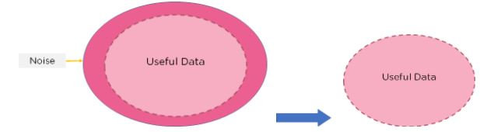
Feature Selection
Feature Selection is the method of reducing the input variables to your model by only using relevant data and getting rid of noise in data

Slide 3

Why We Need Feature Selection

Slide 4
Continue…
Machine Learning models follows a very simple rule:
If we put garbage into our model we can expect the output to be garbage too
Garbage refers to noise or data in feeding our mode.

Slide 5
Feature Selection
Supervised Models
Supervised feature selection refers to the method which uses the output label class for the feature selection. They use the target variables to identify the variables which can increase the efficiency of model.
Unsupervised Models
Unsupervised feature selection refers to the method which does not need the output label class for feature selection. We use them for unlabeled data.

Slide 6
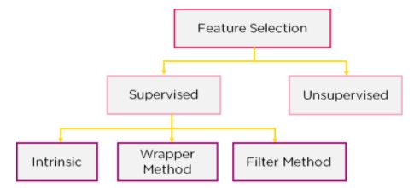
Feature Selection Models

Slide 7
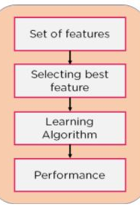
Filter Method
In this method we dropped based on their relation to the output, or how they are correlating to the output.

Slide 8
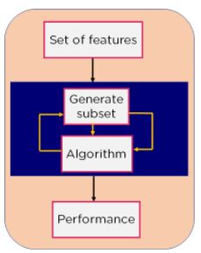
Wrapper Method
We split our data into subsets and train a model using this based upon the output of our model we add the subtracted feature and train our model again

Slide 9
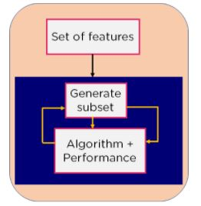
Intrinsic Method
This method combines the quality of both method (Filter + Wrapper)
In this method we take care of machine training iterative process while maintaining the computation cost to be minimum

Slide 10
How to Choose Feature Selection Model
Input | Output | Model
Numerical | Numerical | Pearson correlation coefficient Spearman’s rank coefficient
Numerical | Categorical | ANOVA correlation coefficient (linear). Kendall’s rank coefficient (nonlinear).
Categorical | Numerical | Kendall’s rank coefficient (linear). ANOVA correlation coefficient (nonlinear).
Categorical | Categorical | Chi-Squared test (contingency tables). Mutual Information.

Slide 11
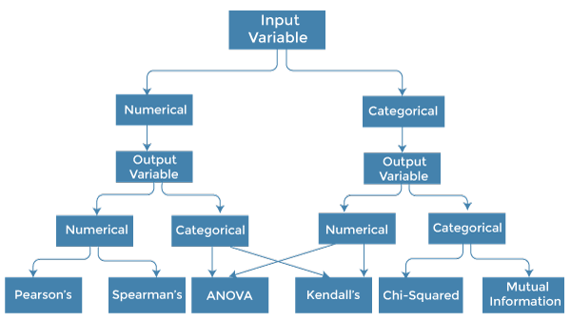

Slide 12

Any Question

Slide 13

Feature Selection with Python

